Slide 1

Topic - Public Transportation Problem in Dhaka City
NAME: Md Amir Shahriar Bin Zaher STUDENT-ID: 2120996
EMAIL: 2120996@iub.edu.bd
COURSE NAME: CIS-101
SECTION: 14
SUBMITTED TO: Dr. Razib Hayat Khan

Slide 2
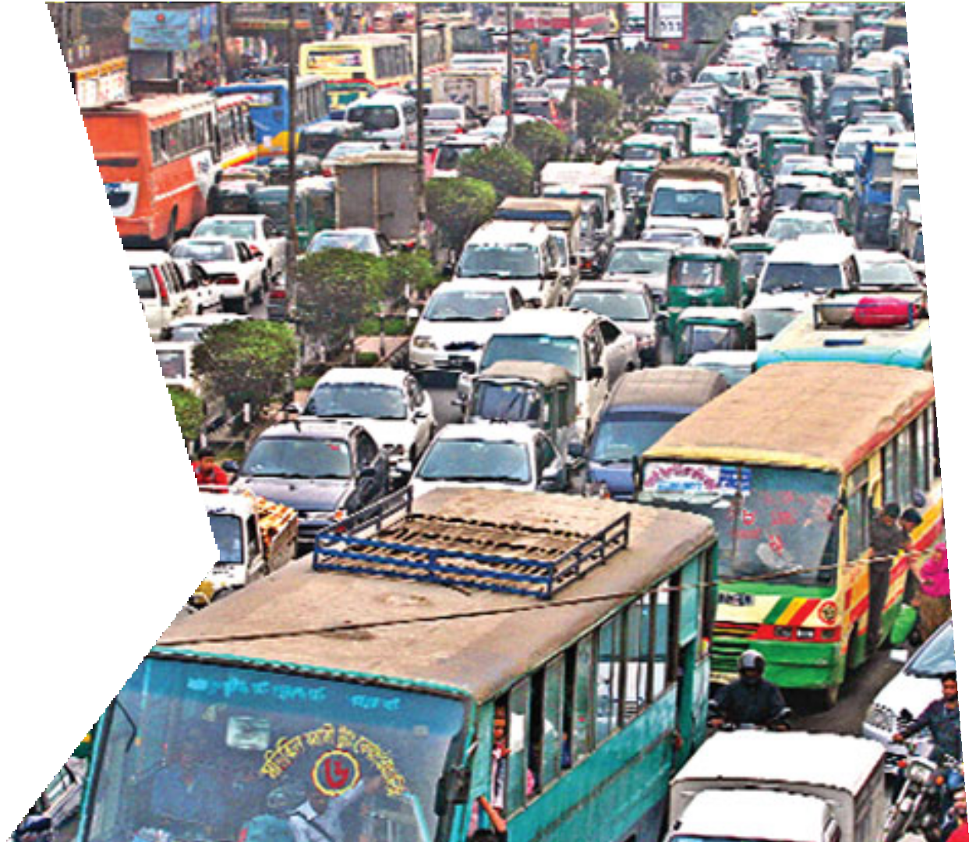






Introduction
Global Livability Survey 2016, Dhaka ranked 137th out of 140 cities
Behavior of the residence and drivers are the main reason for this problem

Slide 3
Scope of work
My Study is focused About
✔ The road transportation Problem
✔ Ignorance of following traffic rules
✔ Impact of human behavior on transportation problem
✔ Economic impact

Slide 4
Methodology
Creating a questioner and letting to know what peoples' opinions are about this problem.
By their occupations, we have separated them which vehicle they like for significant distance and brief distance?
What amount of time does it require for arriving at their objective?
What amount does it cost?
What's more take evaluations for the musings we have given in our overview questions?

Slide 5
Research Questions
What are the major causes of transportation problem in Dhaka?
How this transportation system affecting our daily life?
What are the problems of the transportation system in Dhaka?
Is the there any economic effect for this problem?
How to mitigate the transportation problem in big cities?

